Slide 1
Navigation topics (1)
What is the Resource Library?
Who are the Resource Library Editors/Contacts?
How does the help function work?
How to navigate the Browse List?
What is the overview tab?
How does the document box in the overview box work?
What is the document tab?
How to collaborate in the document tab?
What is the cycle tab?
How does the cycle tab work?
How does a cycle tab look like?

Slide 2
Navigation topics (2)
Can users create their own task/milestones?
Can user created tasks be added to the cycle?
What is the log tab?
What is the member tab?
What is the change tab?
What are the review & approval workflows?
How does the review workflow work?
What to keep in mind when sending a review workflow?
How does the approval workflow work?
What is the agreements/Contracts tab?
Where are Agreements/contracts saved?

Slide 3
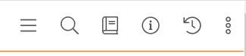
What is the Resource Library?
The Resource Library is a centralised document library for templates, guidance, policies and manuals specific to CBM
The structure of the library is organised according to entities
Documents in the Resource Library can be accessed from Documents tab, and also the Tasks tab and Workflow tab via task templates
Documents that are templates have a ‘T’ to the left of their name
These templates can then be accessed via the ‘New document (from template)’ button on the Documents tab of any page
Only Administrators and users in the ‘Resource Library Editors’ permission group can edit the Resource Library

Slide 4
Who are the Resource Library Editors/Contacts?
Overall liaison and contact persons coordination: Nashon Muhalia
Overall IT technical support and coordination : Petra Strack
Main folders contact persons:
01 Partner: Margarida Silva
02 Projects & Programmes: Nashon Muhalia
03 Donor & Funding: Christian Garbe
04 Geography: Elvira Laub
06 General: Nashon Muhalia

Slide 5
How does the help function work?
The help function provides written guidance to users
If on a page or tab, clicking on the (i) in the Toolbox will open the guidance in the section specific to that page or tab. Navigate to another section by:
Scrolling
Using the Search field (the search looks for words in the section headings, not the content)
Using the section tree
Close the help function by clicking on the ‘x’ in the top right corner
Forms with guidance have an (i) in the top right of the form, click the (i) and the form will expand to show the guidance, close the form guidance clicking on the X in the top right corner
ProMIS Help Text has been customized to reflect CBM specific guidance.

Slide 6
How to navigate the Browse list?
Using a browse list, any user can search from the list of entries by using filter, sort, search and click. There is also a search field function for using free text for easy and quick access to any specific funding.
Filter - use the filters located above the table to reduce the number of pages displayed based on the selected criteria. The Browse list may have a default filter, such as only active pages appearing. To see all pages in the one list, make sure all the filters are blank or have 'All' selected.
Sort - click on the column header to change the sort order of the list;
Search - use the free text Search field located above the table to search for pages containing that text or value.
To see all pages in one list, make sure all the filters are blank.

Slide 7
What is the overview tab?
The Overview tab shows key information about the page, pulling from the creation form, the various functionality tabs and/or other pages
The boxes and information on the Overview tab may change depending on the type of entity (e.g. Projects vs Programmes)
Ideas do not have an Overview tab (or a ‘page’)
In some cases, the overview tab includes boxes that must be manually completed:
Information box in all entities
Partner assessment box in the stakeholder partner entity overview tab
Project status box in the project entity overview tab
Donor requirements box in the funding entity overview tab

Slide 8
How does the document box in the overview box work?
Include the different type of document recent vs favourite
Key documents are a list of folders documents and folders that a user has marked as 'Key' for the Funding page. It is similar to 'Favourites' but this list is specific to the Funding page not the user. Refer 'Managing key documents' for more information.
Recent documents are list of documents in Funding page that have been recently worked on by different users or members. The system automatically updates this list, and it is specific to the page not the user.

Slide 9
What is the document tab?
Each entity has a document tab. The document Search button opens a search field and helps you find a document that you know (part of) the name of. It does not search document contents.
The document tab has a standard folder structure for all entries.
Guidance where to save documents can be found here: https://cbm365.sharepoint.com/sites/ProMis-Live/GuidanceLibrary/06%20General/Document%20management%20in%20ProMIS.pdf

Slide 10
How to collaborate in the document tab?
Send as link(s) will create a link for the recipient. Only ProMIS users will be able to open this link.
Send as attachment(s) will send a copy of the document. Any changes made in that copy will NOT be synchronised back to your saved document.
Share folder allows the user to share a folder with an individual outside CBM.
Set limited permissions (padlock item) enables users with edit access to change the default permission settings of a folder.

Slide 11
What is the cycle tab?
The cycle tab is a standard list of tasks and milestones that are included in the funding/project/stakeholder entity to guide work. Tasks are work steps that have a duration with a start and an end date Milestones are work steps which only have an end date (or deadline)
When a new page is created, the cycle tab is automatically populated with the relevant phases and steps based on the option selected.
Cycle functionality lays out processes on clear step by step to make it easier for users to follow. The cycle is based on CBM QPRGs and process guidance.
The standard tasks includes descriptions to provide additional guidance on what needs to be done and include links to relevant process documents and templates.
Standard tasks include checklists in each step as a reminder on minimum requirements for the particular step.

Slide 12
How does the cycle tab work?
When a page with a cycle tab is created:
The Workflow tab opens with the current phase expanded (e.g., 'Implementation and monitoring') by default. Only the tasks and milestones in the current phase are visible.
The first phase of the workflow will be the ‘active’ phase. The steps within that phase have a Responsible person and a Due date and can be worked on. The Responsible person can reassign the tasks to others and the due dates can be updated if required.
The users can work through the steps of the first phase. Some steps may have a dependency which means they cannot be worked on until a prior step is completed
Each phase will have an ‘End of Phase’ (EOP) step which appears as the last step of the phase. To move to the next phase, the user must complete the End of Phase (EOP) step of the current phase.

Slide 13
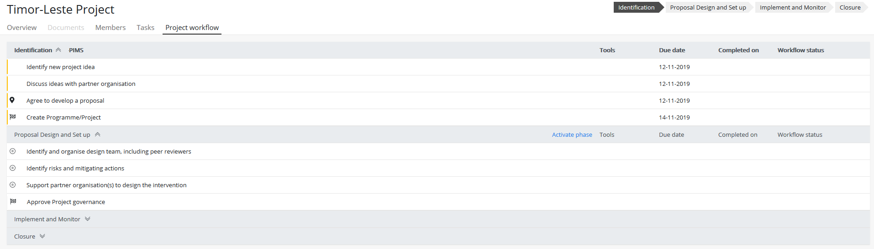
How does a cycle tab look like?
End of Phase
When an ‘End of Phase’ task is completed, the current phase is completed
The project moves to the next phase of the cycle
The tasks in the next phase become active
These tasks also appear in the Tasks tab
Activate Phase
When ‘Activate phase’ is clicked, the tasks in the next phase become active even though the project is not yet in that phase
The project remains in the current phase
The tasks in the next phase become active
These tasks also appear in the Tasks tab
The icons
Displays if this Activity/Milestone has a dependency on a prior Activity/Milestone being completed before it can become ‘active’
Displays if the Activity/Milestone is an ‘End of Phase’ Activity/Milestone, i.e. this Activity/Milestone must be completed to complete the phase and for the cycle to move into the next phase
Displays if this Activity/Milestone is a Milestone (same across the system)

Slide 14
What is the task tab?
Tasks and milestones are the “to do’s” of the system
They allow tasks, deadlines and progress to be captured and tracked.
A Task is something that has a duration of time with a start and end date. It can be used to keep track of tasks (e.g. developing a briefing note).
A Milestone is similar to a task but is one date. Typically used as a deadline, a due date, an event or in instances that require approval. It can be used to keep track of dates (e.g. report deadlines).

Slide 15
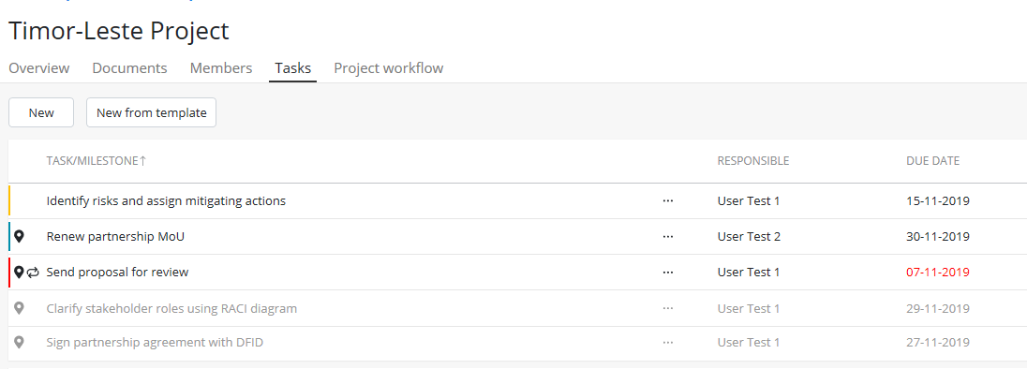
Can users create their own task/milestones?
Users can create a new task/milestone from a blank template (to add their own checklists, review and approval workflows, linked documents etc);
Or from an existing template set up by Administrators (which already contains the templates, review workflows or checklists needed for the activity)
Add a new task/milestone from a blank form
Add a new task/ milestone using a task template set up by the Administrator

Slide 16
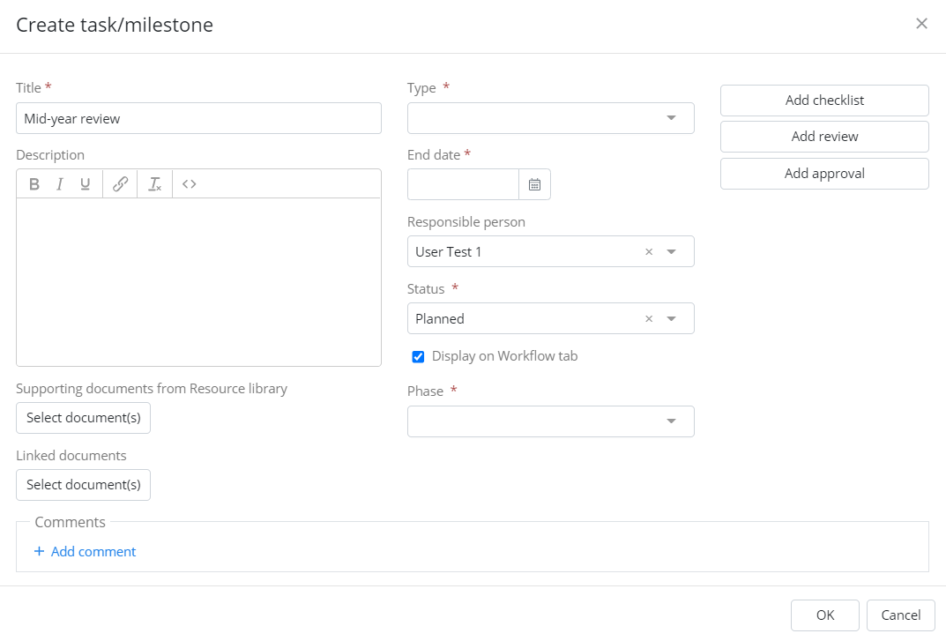
Can user created tasks be added to the cycle?
Tasks created by the user can be added to the project/stakeholder/funding cycle
When setting up the task, check the ‘Display on Workflow tab’ checkbox and select the workflow phase you want to insert the task into
The task will appear in the workflow tab with a special icon to show it was added manually

Slide 17
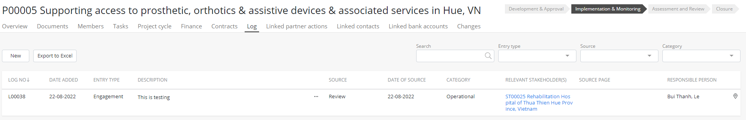
What is the Log tab?
The Log tab provides a space to capture updates, decisions, learnings etc. related to the page
Documents can be linked to a Log entry (e.g. meeting minutes, reports)
If a log entry is linked to another page (e.g. to a Partner), that entry will also appear on that linked page’s Log tab. The original page is shown in the ‘Source page’ column
If there are specific actions or milestones for the entry, these can be recorded as milestones against the entry at the bottom of the form. These appear in the Tasks tab with the icon

Slide 18
What is the members tab?
All Standard Users have read-only access to pages in the system (except FR requirements) unless they are added as a Member
Only Members (and Admins and Superusers) can edit information on a page, such as upload documents, create tasks and modify metadata
Any page can have more than one member, but only one responsible person.
Any existing Member can add new Members to the page (or edit/delete existing)
All pages that you are a Member of appear in the ‘My sites’ box on your Start page
When a page is created, any users selected in the form are automatically added as Members to the page

Slide 19
What is the changes tab?
The Changes tab tracks changes to selected fields within an entity form via an approval workflow
Appears on Projects and Stakeholder pages only
On Projects, the tab is activated once the project enters the ‘Implementation’ phase of the workflow
On Stakeholders, the tab is activated as soon as the page is created
When the Changes tab is enabled, certain fields within the form become ‘locked’ and can only be edited via approval on the Changes tab.
When the change is being made on the Changes tab, it can have a Review and/or an Approval and may need supporting document(s) to be linked and/or a comment of why the change is being made.

Slide 20
What are the review & approval workflows?
Review and approval workflows are used to seek approval or share information with another person/team.
Review and approval workflows are triggered from a task. The person to whom the workflow is sent receives a notification via email.
Reviews are mostly not mandatory and can be used to share documents, information or tasks with other teams.
Approvals are mandatory and must be completed in line with CBM’s authority matrix.

Slide 21
How does the review workflow work?
Concurrent review: The review is sent to all reviewers at the same time (and they can review in any order)
Sequential review: The review is sent to each reviewer step-by-step (and they must review in the set order)
‘End review’: If some reviewers are unable to complete their review (e.g. they are on vacation) but the sender needs to finalise the review, the sender can click the ‘End review’ button. This ends the review workflow in its current state, showing which reviews were completed and which were not.
‘Recall review’: If the sender needs to amend the review after they’ve sent it, they can click the ‘Recall review’ button. This recalls the active review (removing any already completed review steps as part of that workflow) so the sender can make the relevant edits and send for review again.

Slide 22
What to keep in mind when sending a review workflow?
The reviewers should be added as a member of the entity page so as to put comments on the linked documents.
No edition should be made by task owner on the linked document once is has been sent for review or approval.

Slide 23
How does the approval workflow work?
Approvals are always sequential (i.e. sent to each approver in turn)
Once the final approver is done, the status of the task changes to ‘Completed’ (but the task can be re-opened via the ‘Edit’ button if needed)
‘Recall approval’: If the sender needs to amend the approval after they’ve sent it, they can click the ‘Recall approval’ button. This recalls the active approval (removing any already completed approval steps as part of that workflow) so the sender can make the relevant edits and send for approval again.
Once an approval is completed, a PDF of the approval is automatically generated and saved in the ‘Approvals’ folder in the Documents tab
Important: No edition should be made by task owner on the linked document once is has been sent for review or approval!

Slide 24
What is the agreements/Contracts tab?
The Agreements/Contracts tab captures key information about agreements related to a page
Agreement/Contracts files are saved in the Documents tab and linked to the entries
If an agreement is linked to another page (e.g. to a Partner), that agreement will also appear on that linked page’s Agreements tab. The original page is shown in the ‘Source page’ column
If there are specific dates or deadlines for the agreement (e.g. reporting deadlines, review dates), these can be recorded as milestones against the agreement at the bottom of the form. These appear in the Tasks tab with the icon

Slide 25
Where are Agreements/contracts saved?
 | SharePoint | ProMIS entitities
 | Contract database (Bensheim & Initiative teams) | Stakeholder partner | Stakeholder donor | Project entity | Programme entity | Funding entity
Mandatory | Funding contract, including amendments, extension, addendums, auxiliar conditions, etc Service, consultancy, procurement, and any other contracts related to a project (except partner project contract) | MoU or collaboration agreements signed with the partner | MoU or teaming agreements signed with (potential) donors | Partner project contract Amendments to partner project contract | Partner project contract Amendments to partner project contract
Nice to have (could be uploaded but not mandatory |  |  |  |  |  | Funding contract

